Slide 1
BANKRUPTCY PREVENTION
Ms.Dipali Naskar
Ms.Soumya Mallar
Ms.Rayavarapu Sipada Saranya
Ms.Korasikha Poojitha
Ms. Manasa S
Sneha
Ms.Nikita Netaji Lomte

Slide 2
Business Objective: This is a classification project, since the variable to predict is binary (bankruptcy or non- bankruptcy). The goal here is to model the probability that a business goes bankrupt from different features. The data file contains 7 features about 250 companies The data set includes the following variables:
industrial_risk: 0=low risk, 0.5=medium risk, 1=high risk.
management_risk: 0=low risk, 0.5=medium risk, 1=high risk.
financial flexibility: 0=low flexibility, 0.5=medium flexibility, 1=high flexibility.
credibility: 0=low credibility, 0.5=medium credibility, 1=high credibility.
competitiveness: 0=low competitiveness, 0.5=medium competitiveness, 1=high
competitiveness.
operating_risk: 0=low risk, 0.5=medium risk, 1=high risk.
class: bankruptcy, non-bankruptcy (target variable).

Slide 3
SUMMARY
1.Data Preparation
2.Exploratory Data Analysis
3.Data Modelling
4.Model Evaluation
5.Model Deployment

Slide 4
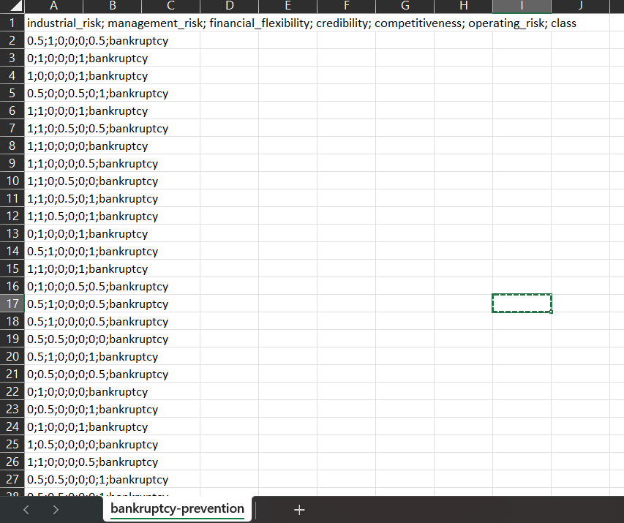
Raw Data is extracted from the Excel file

Slide 5

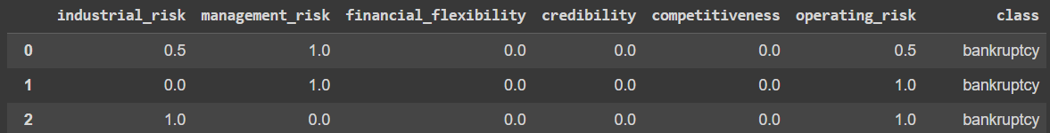
Data Preparation
Code to read data in Google Collaboration
The data is extracted as follows

Slide 6
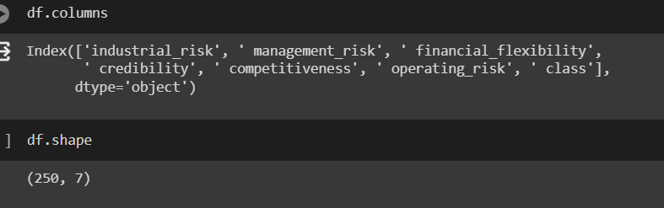
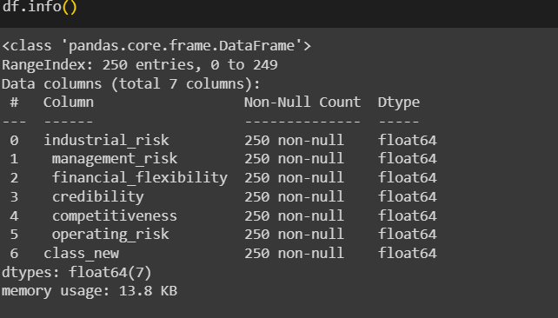
Analyse the data
Check the
1.Columns in the data
2.Rows in the data
3.Info of the data

Slide 7
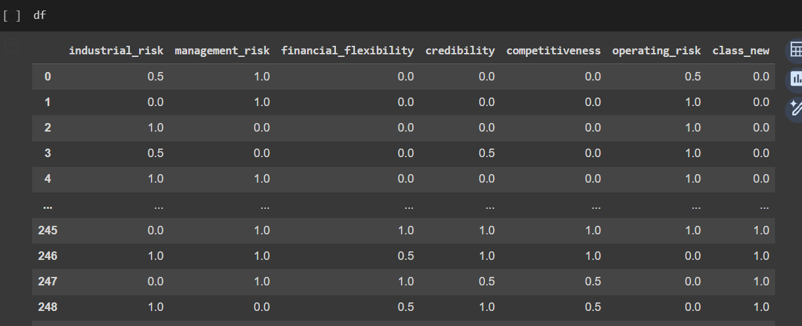
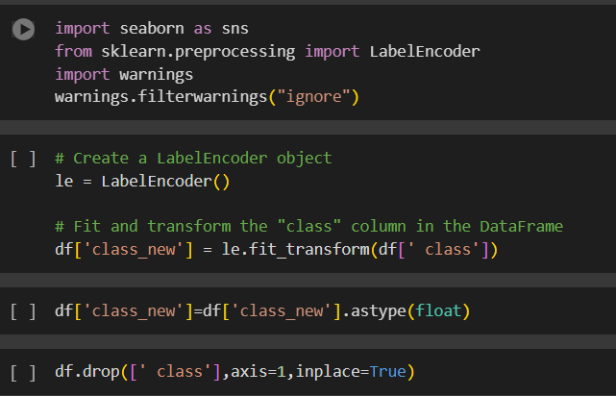
Label Encoding
Change the data in class – Bankruptcy / Non- Bankruptcy to 0 and 1’s

Slide 8
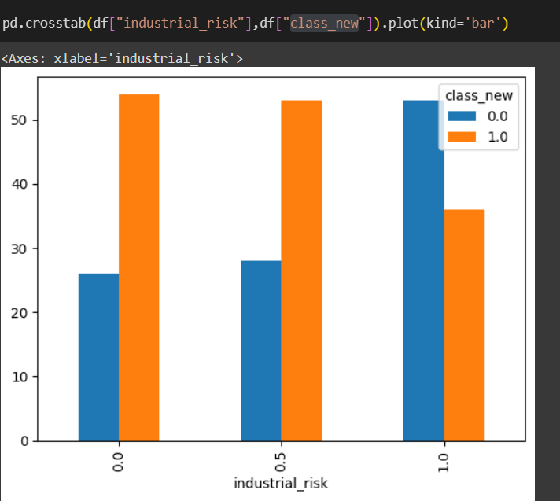
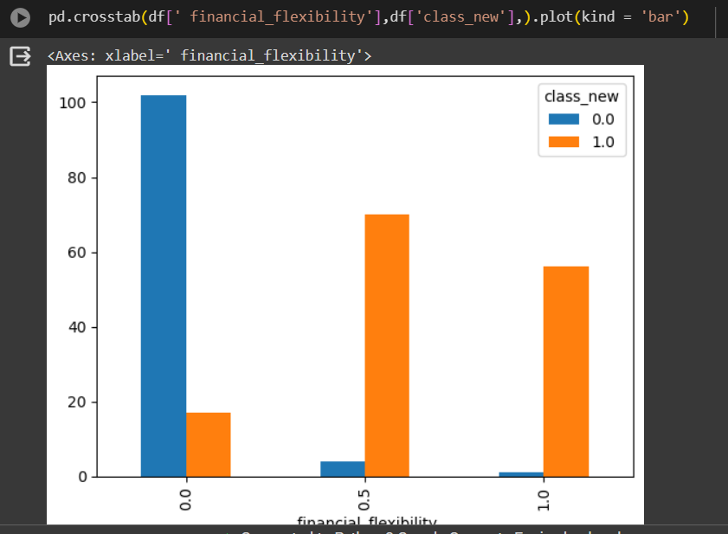
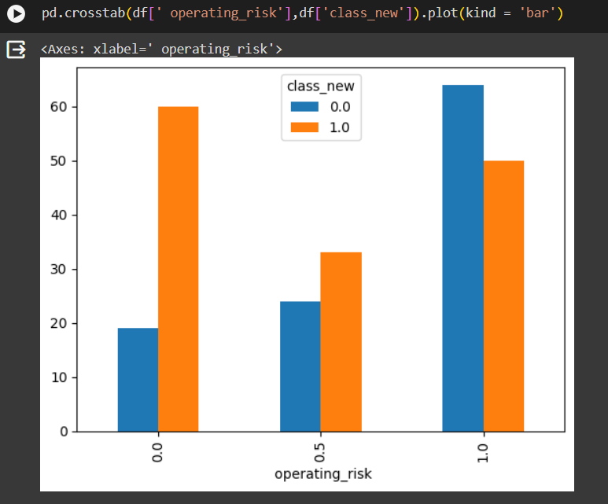
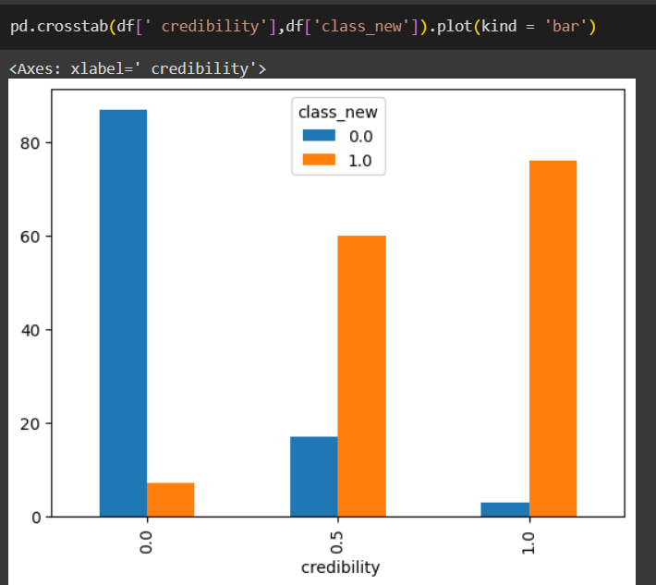
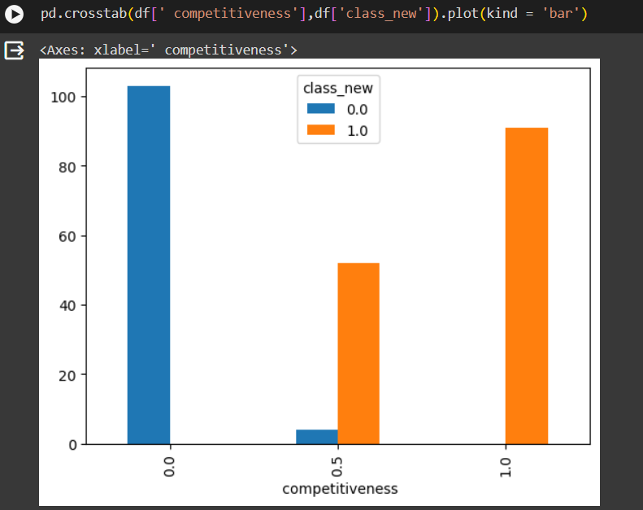
Exploratory Data Analysis
Compare each column with the Class_new Column

Slide 9
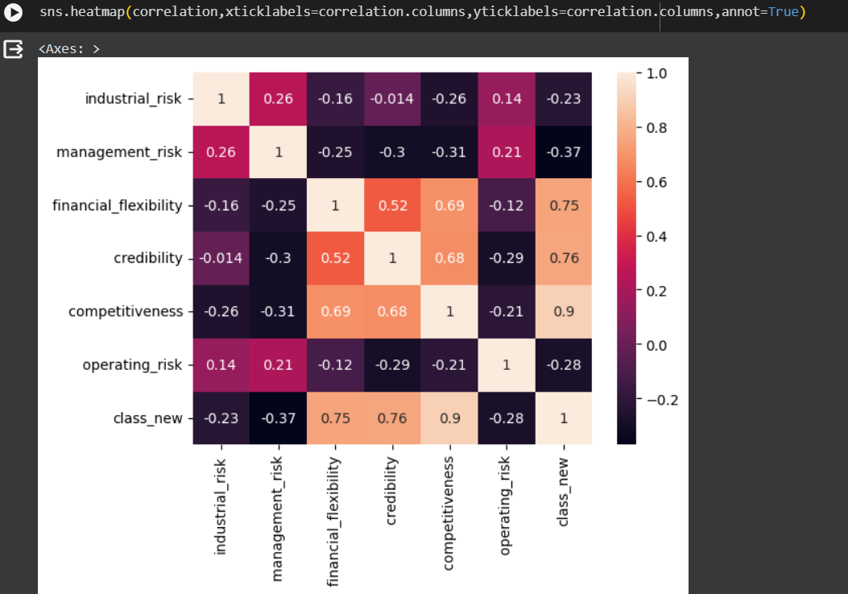
Check the Heatmap for Correlation

Slide 10

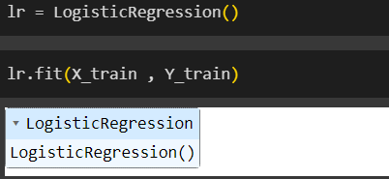
Data Modelling
Apply Logistic Regression for the data by importing packages
Apply Train and Test Data
Select the Test size as 0.25 with random state ‘0’

Slide 11
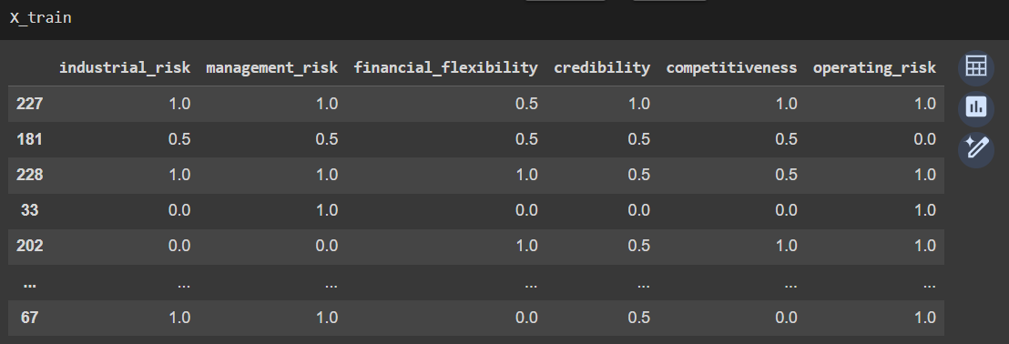
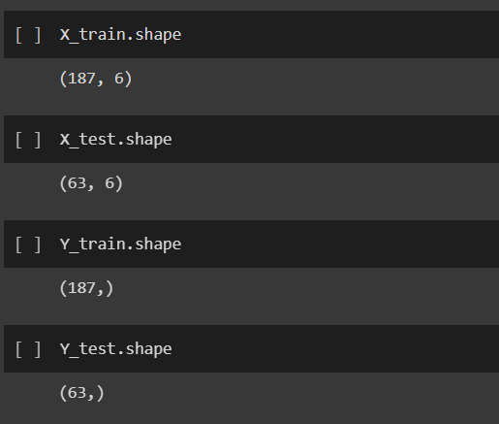
Check the data in X_train , Y_train,X_test,Y_test

Slide 12
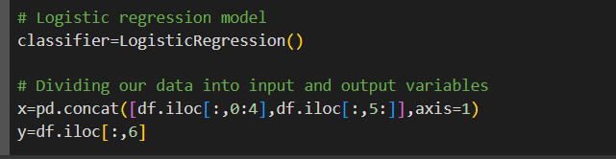


Use Classifier for applying Logistic Regression
Divide the data into input and output data

Slide 13
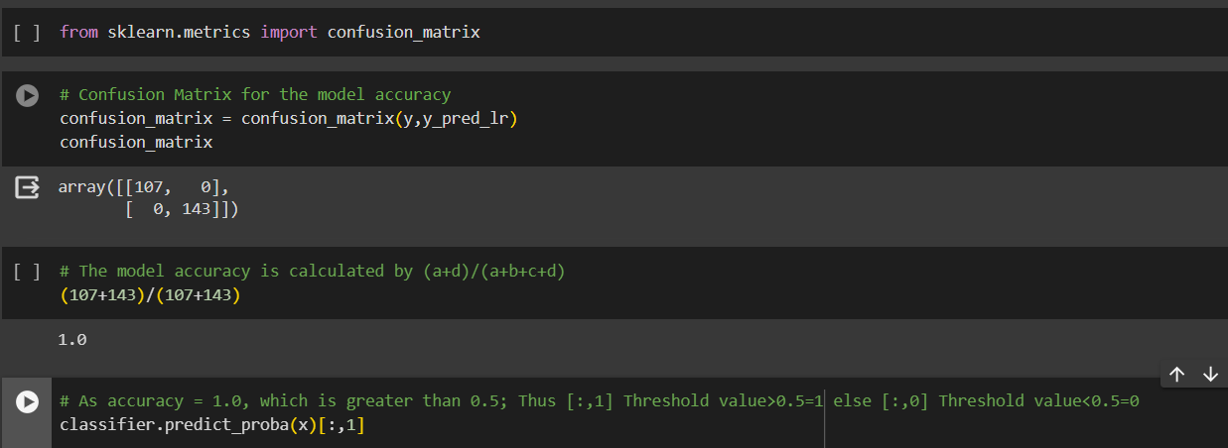
Check the confusion matrix for model accuracy

Slide 14
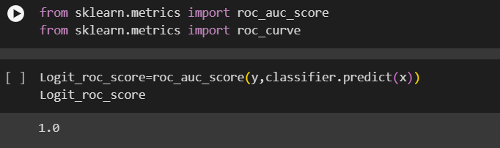
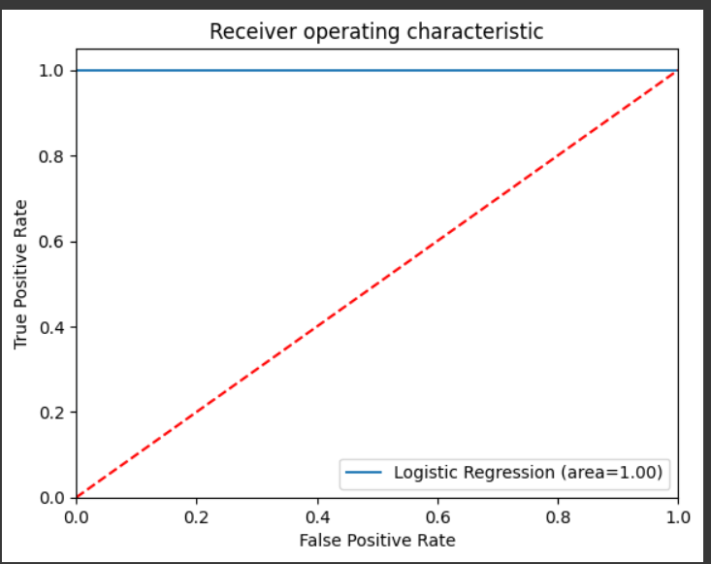
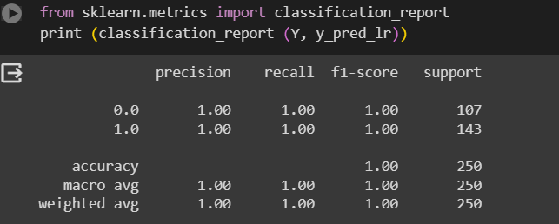
Check the classification report
Check the roc Curve score
Check the graph for Logistic ROC Curve value=1.0

Slide 15
Model Evaluation
Applied below techniques for Model Evaluation
Random Forests
Support Vector Machine
Naïve Bayes
Neural Networks
Decision tree

Slide 16
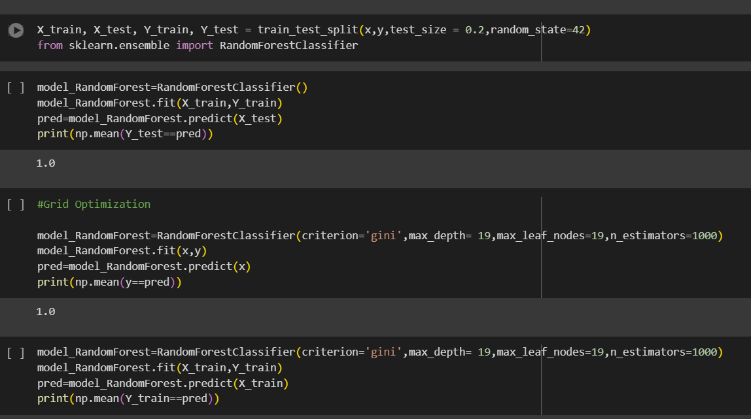
Random Forests
The model accuracy in Random Forests is obtained as 1.0

Slide 17
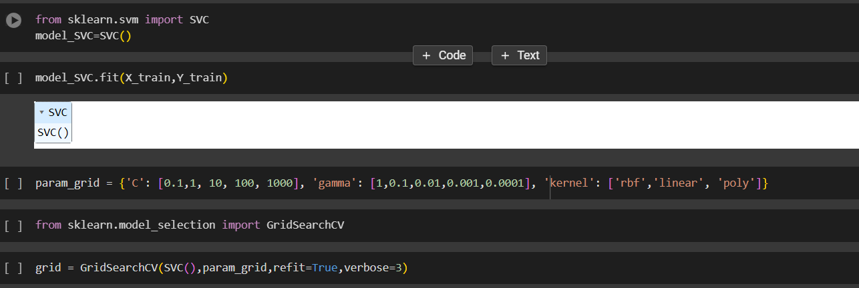
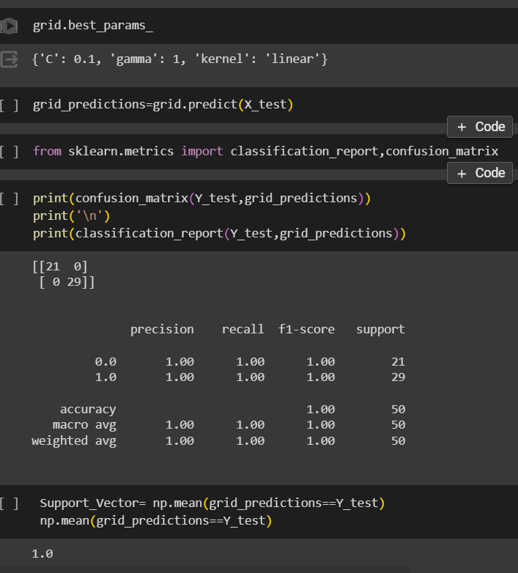
Support Vector Machine
The model accuracy obtained from support vector machine is 1.0

Slide 18
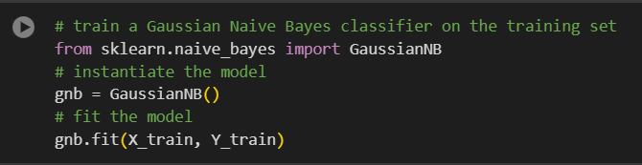

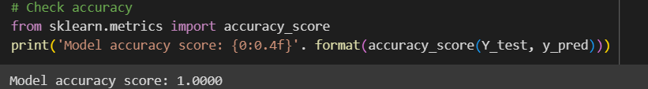
Naïve Bayes
The Model Accuracy score obtained from Naïve bayes is 1.0

Slide 19
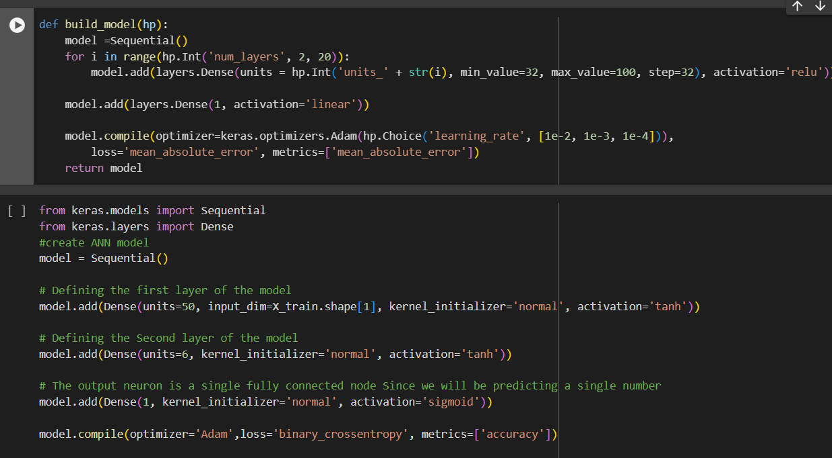
Neural Network
The Model accuracy in Neural Network is 0.9848

Slide 20
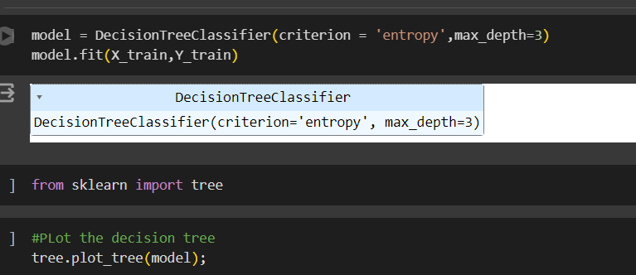
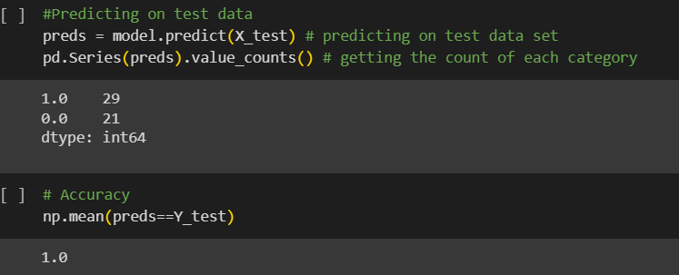
Decision Tree
The model accuracy for decision tree is 1.0

Slide 21
THANK YOU

